Slide 1
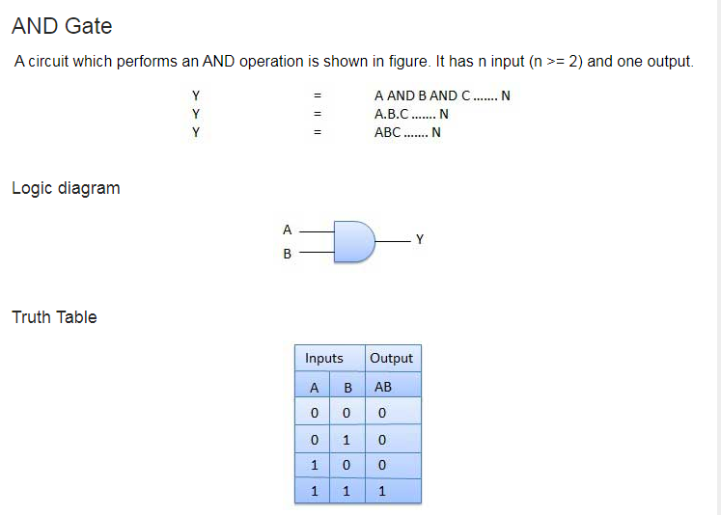

Slide 2
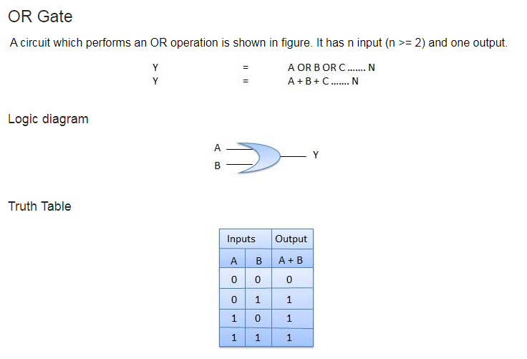

Slide 3
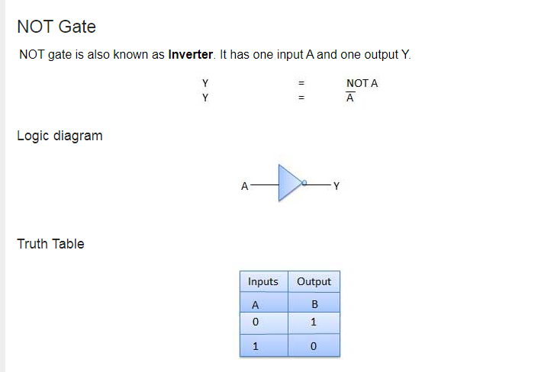

Slide 4
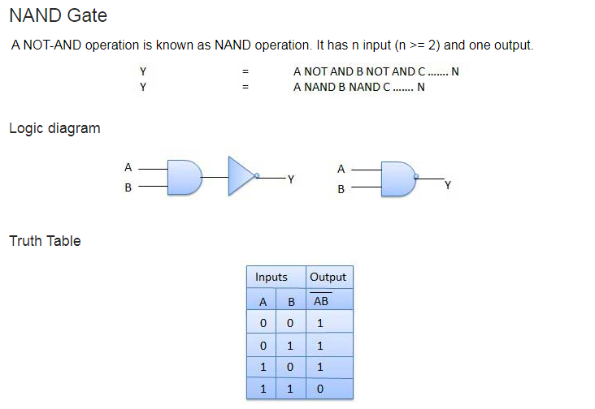
The Logic NAND Gate function is sometimes known as the Sheffer Stroke Function and is denoted by a vertical bar or upwards arrow operator, for example, A NAND B = A|B or A↑B.

Slide 5
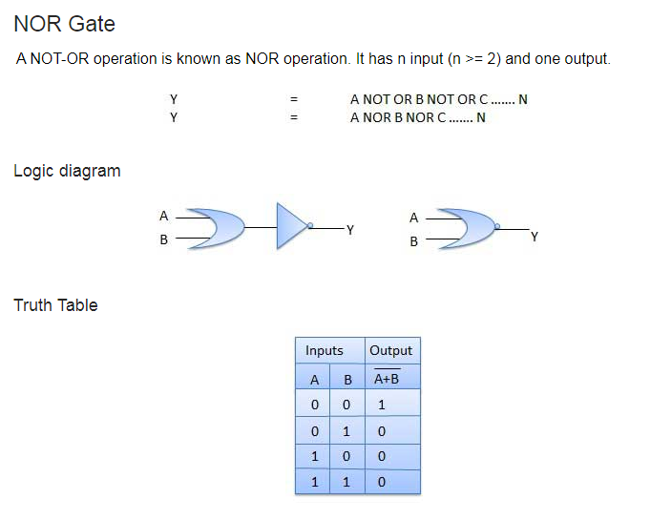
The Logic NOR Gate function is sometimes known as the Pierce Function and is denoted by a downwards arrow operator as shown, A↓B.

Slide 6
The inclusive NOR (Not-OR) gate has an output that is normally at logic level “1” and only goes “LOW” to logic level “0” when ANY of its inputs are at logic level “1”. The Logic NOR Gate is the reverse or “Complementary” form of the inclusive OR gate

Slide 7
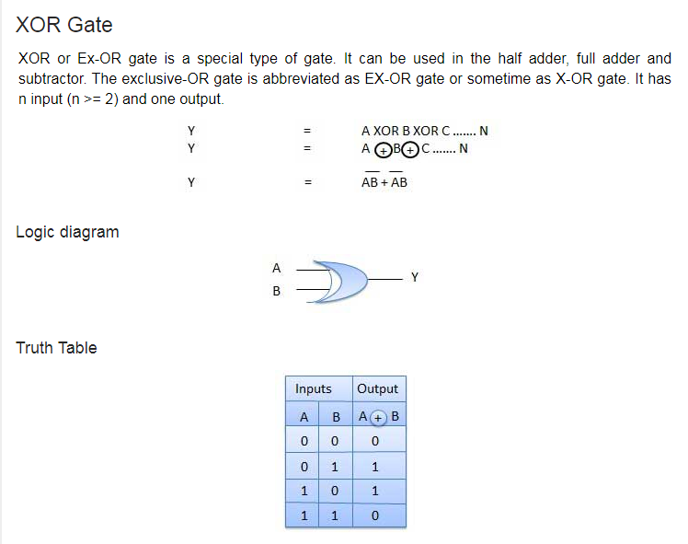

Slide 8
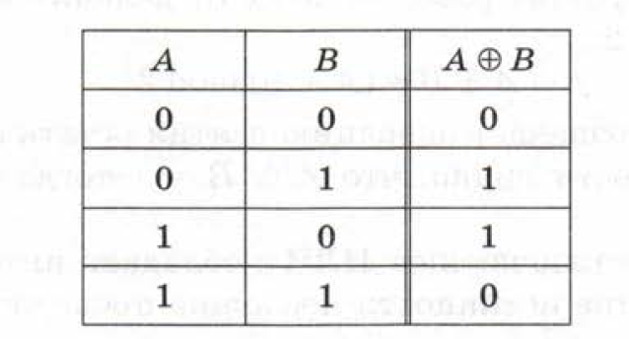


Slide 9
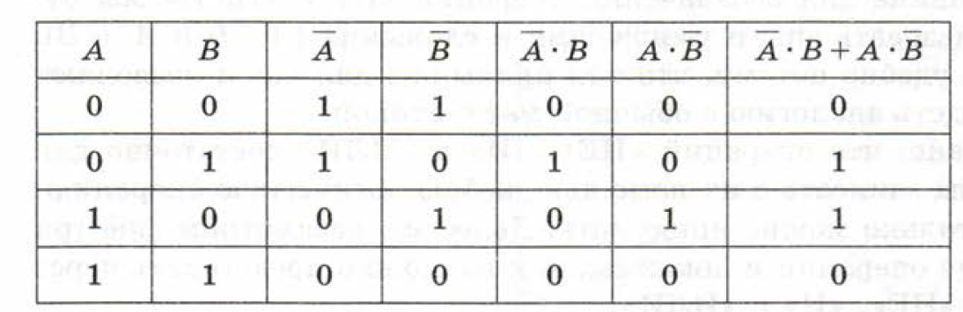
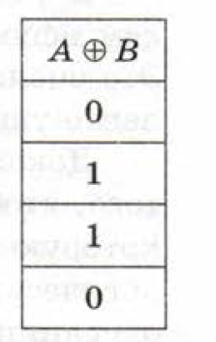

Slide 11
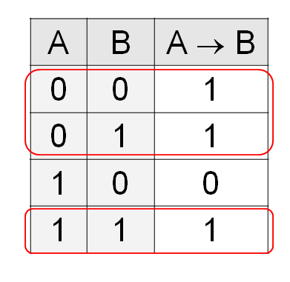
Logical Implication

Slide 12
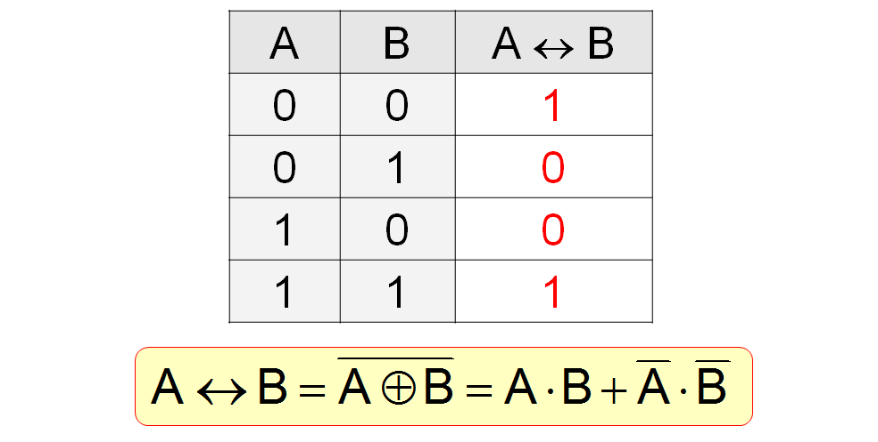
Logical Equivalence

